Slide 1
DATA COMPRESSION AND DECOMPRESSION USING LEMPEL-ZIV-WELCH TECHNIQUE
Under the guidance of:-
Uppara Rajanikanth By:- Rahul Raj
Amit Singh
Ankit Sinha
Notes:
Delete this slide when you finish preparing the other slides.

Slide 2
Abstract
The project aims to design the modified LZW algorithm on source coding and improve the compression efficiency of the existing algorithms.
The LZW algorithm is compared with respect to encoding and decoding speed, memory requirements and compression ratio also it is optimised for hardware implementation.
LZW algorithm is evaluated for use in the removal of the redundancy in computer files that satisfies the requirements of the applications and for the efficient data compression and decompression.

Slide 3

Introduction
LZW is a lossless compression technique, lossless.
If data have been losslessly compressed, the original data can be recovered exactly from the compressed data after a compress cycle.
The coding starts with an initial dictionary, which is enlarged with the arrival of new symbol sequences.
LZW compression works by reading a sequence of symbols, grouping the symbols into strings, and converting the strings into codes.
Encoding and Decoding is used in LZW for compression and decompression.

Slide 4

BACKGROUND STUDIES
Research paper by international journal of advanced research in computer science and software engineering (03 march 2012).
In this paper the problem of combining and summarizing LZW algorithm with binary search and multiple Dictionaries data compression reduces the complexity of time at the maximum is analyzed.
Research paper on LZW data compression algorithm by American Journal of Engineering Research (AJER) (2014)
The author has described the encoding and the decoding process with example in his research paper. In encoding algorithm a sample string is used to demonstrate the algorithm.
Lempel-Ziv-Welch (LZW) Encoding Discussion and Implementation by Michael Dipperstein.
In his paper he explained about encoding of LZW that unlike LZSS, entries in the LZW dictionary are strings and every LZW code word is a references to a string in the dictionary.

Slide 5


problem statement
Technology is growing in every aspect but the basic need to save the memory and time utilization still
remains. Whenever we deal with any kind of data, Users are bound to compress the data to minimize
the space utilization. So this project aims to implement Lempel-ziv-welch algorithm and to modify it that helps user to get a better platform to compress data in less time with no data loss.

Slide 6

OBJECTIVES
Implementation and Modification of the compression and decompression algorithm by lempel-ziv-welch.
Implementing data file handling through C programming.
COMPRESSION RATIO Of the difference between file size of an uncompressed data and the file size of the same data when compressed.

Slide 7

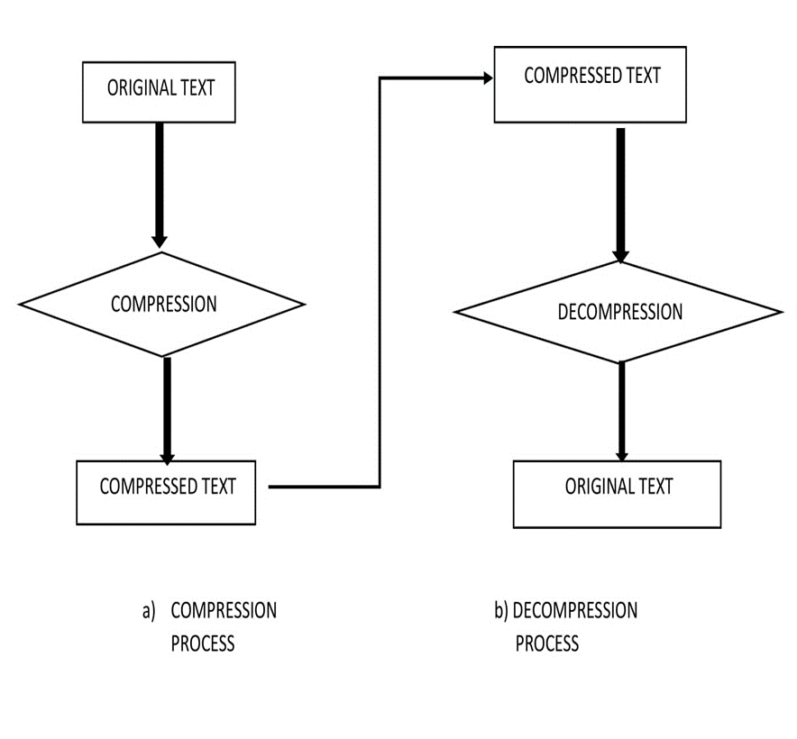
DESIGN
ENCODING:- A dictionary is initialized to contain the string .The algorithm works by scanning all string input until unique one and this new string is added in the dictionary.
DECODING:- The algorithm works by reading a value from the encoded input and outputting the corresponding string from initialized dictionary.

Slide 8
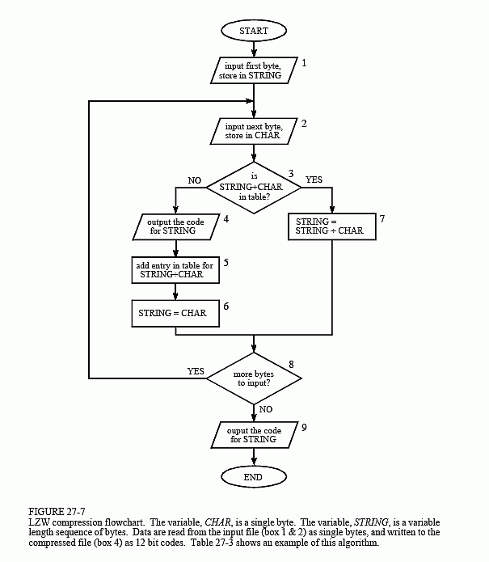
COMPRESSION:- FLOW CHART
String:- A B A B B A B C A B A B B A
INDEX | ENTRY
1 | a
2 | b
3 | c
ENCODED DICTIONARY-
ENCODED OUTPUT | INDEX | ENTRY
 | 1 | a
 | 2 | b
 | 3 | c
1 | 4 | ab
2 | 5 | ba
4 | 6 | abb
5 | 7 | bab
2 | 8 | bc
3 | 9 | ca
4 | 10 | aba
6 | 11 | abba
1 | - | -
ENCODED OUTPUT SEQUENCE- 1 2 4 5 2 3 4 6 1

Slide 9
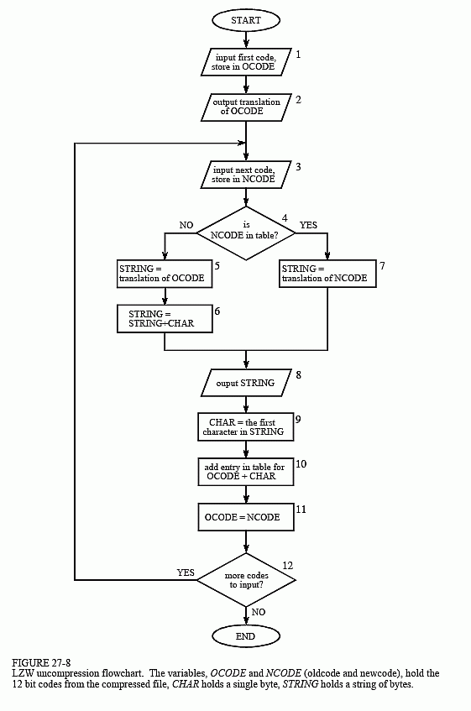
Decompression:-
ENCODED OUTPUT-1 2 4 5 2 3 4 6 1
RECEIVED | DECODED | INDEX | ENTRY
 |  | 1 | a
 |  | 2 | b
 |  | 3 | c
1 | a | - | -
2 | b | 4 | ab
4 | ab | 5 | ba
5 | ba | 6 | abb
2 | b | 7 | bab
3 | c | 8 | bc
4 | ab | 9 | ca
6 | abb | 10 | aba
1 | a | 11 | abba
DECODED OUTPUT- A B A B B A B C A B A B B A

Slide 10
Looks like sounds like
IMPLEMENTATION
The characters were imported using the file handling named as unixdict.txt. The variable assigned as fd also the size of the set is also determined using the function _setsize First we allocated memory according to item size.
Again the memory is allocated for encoded text. Then we implemented the set of rules for encoding by using array and a dictionary created using structure. Using the structure we assigned set of codes with specific letter such as dict[10224] for c dict[387] for b and dict[97] for A.
we implemented lzw algorithm for encoding and decoding. Next new code would be too long for the current table so, if next code=next shift then table reset to 8 bit then reset back to 9 bit. Then table clear must occur before bit reset. Then the input size is determined. The input size and encoded size is determined using LZW.

Slide 11
Decompression:- 1. initialize dictionary with single character strings 2. OLD = first input code 3. output translation of OLD 4. WHILE not end of input stream 5. NEW = next input code 6. IF NEW is not in the string dictionary 7. S = translation of OLD 8. S = S + C 9. ELSE 10. S = translation of NEW 11. output S 12. C = first character of S 14. OLD + C to the string dictionary 15. OLD = NEW 16. END WHILE
PSEUDO CODE:-
Compression:-
Initialize dictionary with single character strings
P = first input character
WHILE not end of input stream
C = next input character
IF P + C is in the string dictionary
P = P + C
ELSE
output the code for P
add P + C to the string dictionary
P = C
END WHILE
output code for P

Slide 12
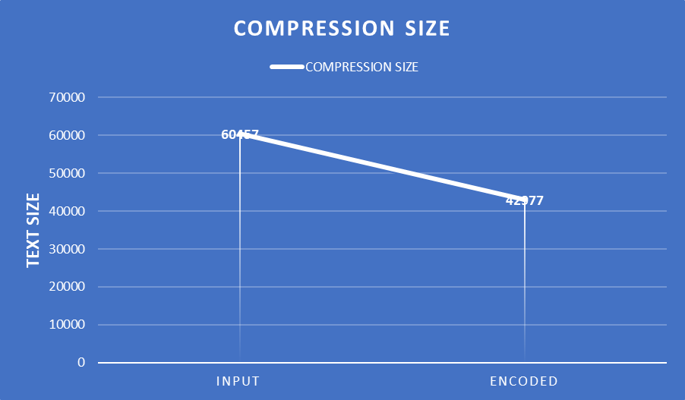
OUTPUT SCREEN

Slide 13
RESULT ANALYSIS
This project addresses the necessity of the data size in storage devices. Basically the LZW technique finally gives the compressed file that is half the size of the actual file and algorithm is designed such that it compress any text file better than any other compressing algorithm.
LZW data structure implementation gives the better. The characters were imported using the file handling named as unixdict.txt.
Then we implemented the set of rules for encoding by using array and a dictionary created using structure. LZW has various advantages when being used to compress large text data, in English language which has high redundancy.
It’s a lossless compression algo, Hence no information lost, the disadvantage or we can say there is a case when dictionary becomes too large. One approach is to throw the dictionary away when it reaches a certain size. Useful only for a large amount of text data where redundancy is high.

Slide 14
CONCLUSION AND FUTURE SCOPE
In this age the main problem is to store the data without loosing it. The limited amount of store becomes a big problem to the users. Hence, the compression technique has a great scope in today’s environment.
We have seen that with help of LZW how we can reduce the size of any text file and maximize the capacity of the hard drives. It’s a Dictionary Based algorithm, but as we know the dictionary structure gets flatten out after compression.
In Future I would like to implement an LZW variant using Hash Sets and find out the performance with respect to LZW also it requires no prior information about the input data stream and also it can compress the input stream in one single pass. Another advantage of LZW its simplicity, allowing fast execution.

Slide 15
THANK YOU

